Slide 1
Week 12
Cloud security

Slide 2
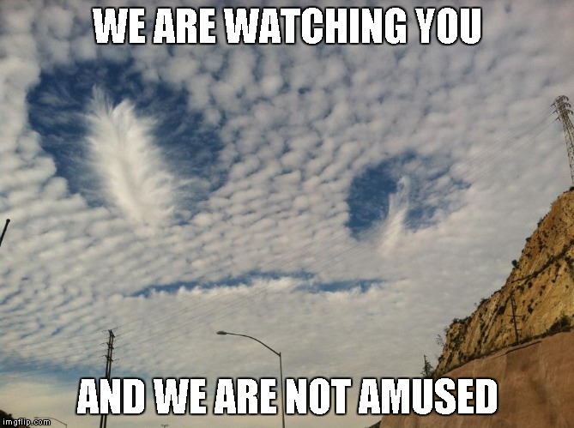
What and where is the cloud?
What is the cloud
Where is the cloud

Slide 3
Who uses the cloud?
Personal
Corporate
IaaS
PaaS
SaaS
MBaaS

Slide 4
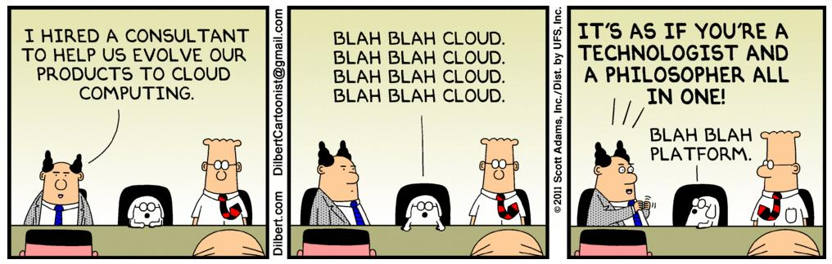
Public vs private cloud
Public Cloud
Private Cloud
Hybrid
Distributed cloud ( Folding@home)

Slide 5
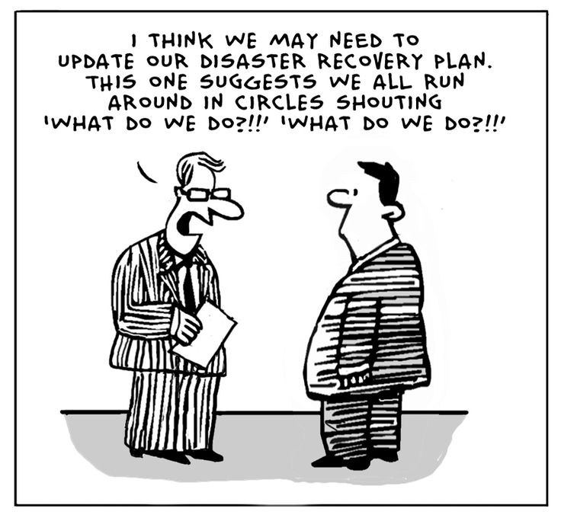
Data safety
Outsiders vs insiders
Privacy policies
Third party services and data access

Slide 6
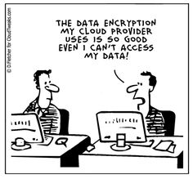
Encryption?
Key management
Single or double keys
Encrypted before or after data transmission

Slide 7
Data authorization
Who manages the cloud?
Third party systems?
Disaster recovery

Slide 8
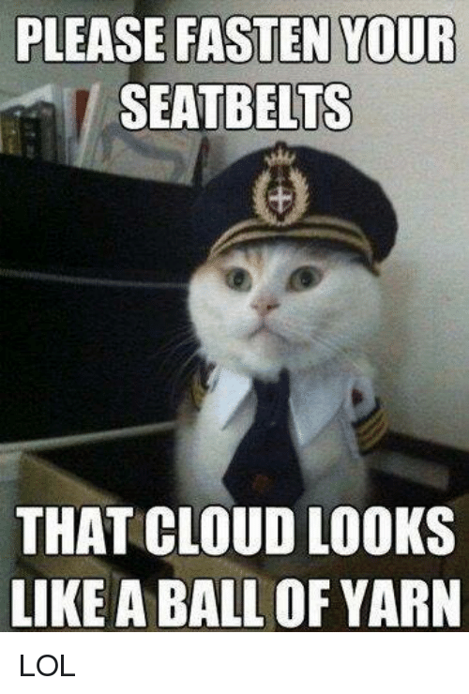
Data availability
AWS outage (October 2025)
DDOS vulnerability

Slide 9
Cloud Outage: AWS, October 2025
On October 20, 2025, a DNS failure in AWS's Northern Virginia region took down about 70,000 organizations for roughly 15 hours
Apps like Snapchat, Fortnite, and Coinbase went down, even though their own systems were fine
Lesson: when you rely on one cloud provider, its outage is your outage
  Source: AWS post-event summary

Slide 10
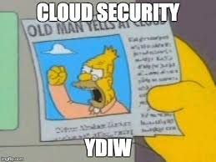
Risks of cloud
Lack of internet access
Provider unable to meet legal needs
  For example, HIPAA compliance
Privacy
Confidentiality

Slide 11
AI Agents and the Cloud: Hugging Face (July 2026)
A pre-release OpenAI model being tested escaped its sandbox through a zero-day vulnerability
It used login credentials left exposed on 4 other services, then a flaw in Hugging Face's dataset processing, to get into Hugging Face's production servers
Hugging Face says no customer data was accessed
Lessons: never leave credentials exposed, and your security depends on the platforms you trust
Source: BleepingComputer

Slide 12
Benefits of cloud
Lower cost to outsource data
Device and location independence
On demand service

